Slide 1
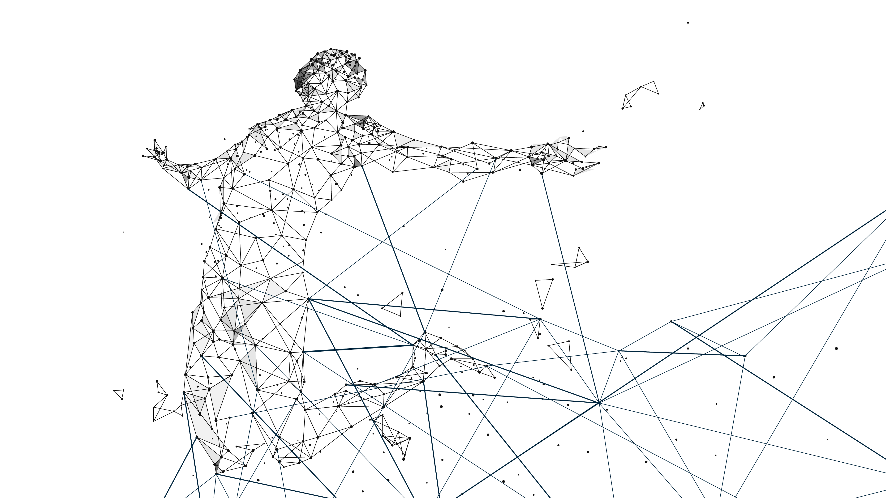
Service reporting for RBAL for 2026-07-31

Slide 2
Service Reporting for
PSD2 Regulatory
Category | Blocker | Critical | Major | Minor | Trivial
# of incidents/service req | 0 | 0 | 0 | 0 | 0
# of violation of resp/neut/reso times | 0 | 0 | 0 | 0 | 0
# of reopend Incidents/service req | 0 | 0 | 0 | 0 | 0
# of rejected Incidents/service req | 0 | 0 | 0 | 0 | 0
AVG resolution time of incidents/service req | 0 min | 0 min | 0 min | 0 min | 0 min
SLA KPI Throughput time | Value
# of total API Calls | 2.475
# of total API Calls within <=3s | 2.475
SLG of API Calls within <=3s | 100%
SLA KPI Throughput time detailed | Value
# of total API Calls > 3s | 0
# of total API Calls in SP boundaries <= 1,5s | 0
Adapted SLG of API Calls | 100%
SLA KPI Throughput time | Value
# of security incidents | 0
# of major incidents | 0

